Slide 1
PROGRAMMING
ACE
December 15, 2016

Slide 2
Why design anything in the first place?
CURRENT WORLD + NEW POSITIVE IDEA = DESIGN
If IDEAS = JOYFUL + HAPPY, then DESIGN = JOYFUL + HAPPY
YOU, AS A DESIGNER = OPTIMISTIC FOR A BETTER WORLD

Slide 4
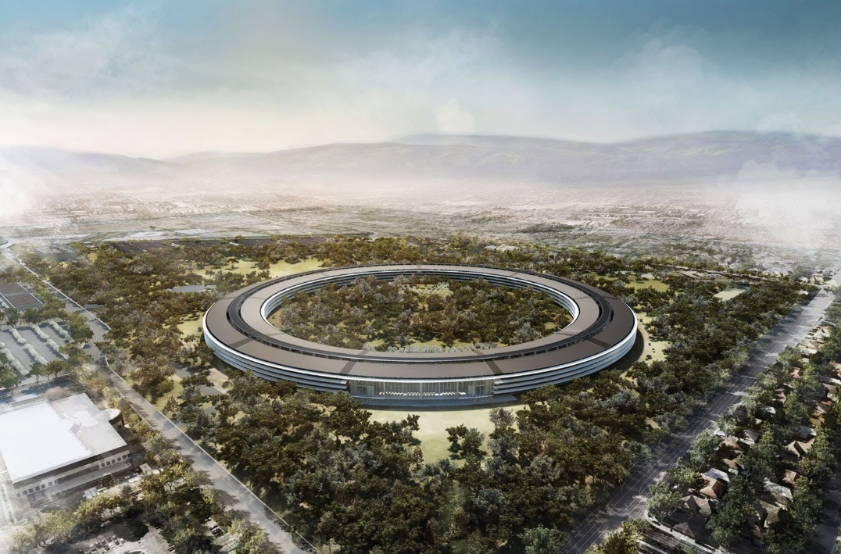
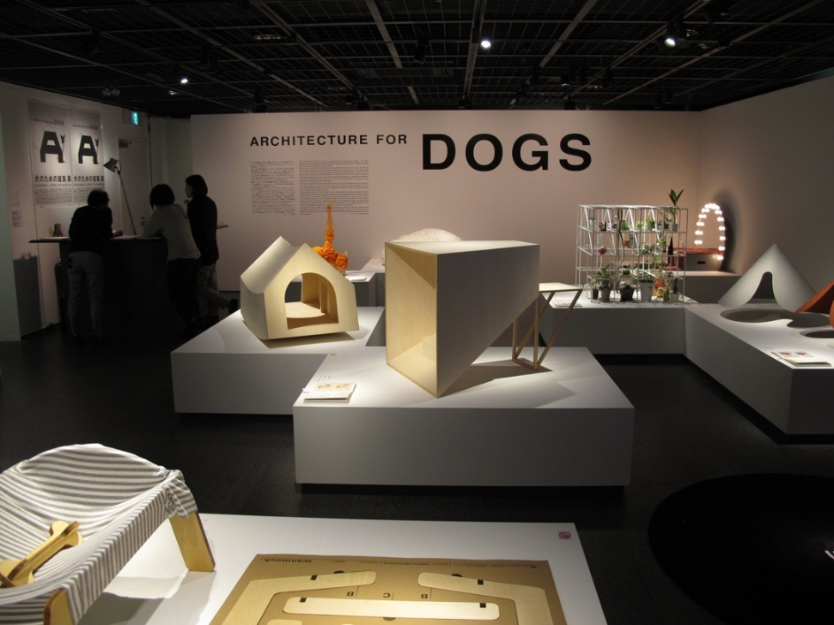
1. Client

Slide 5
Keep the Public in mind!

Slide 6
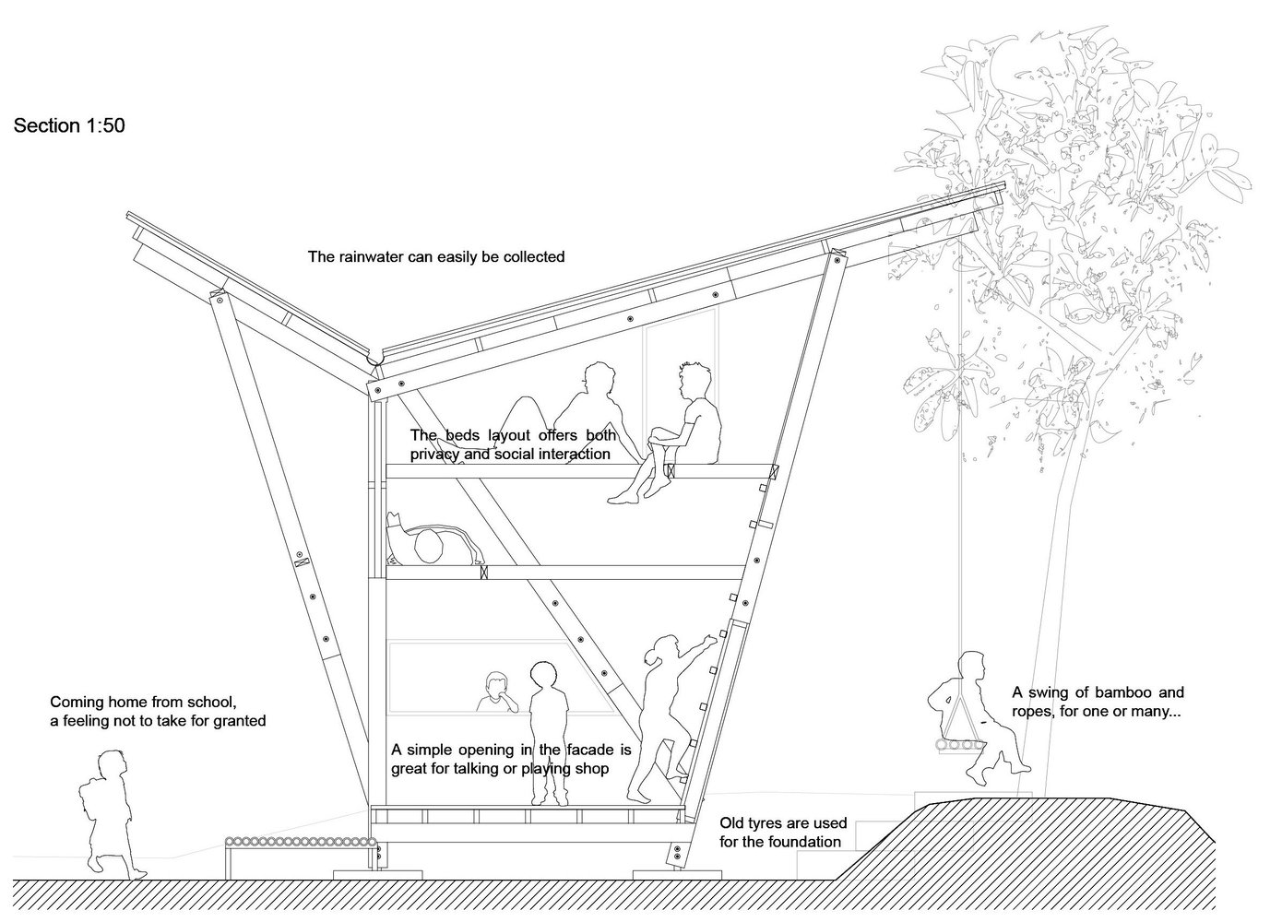
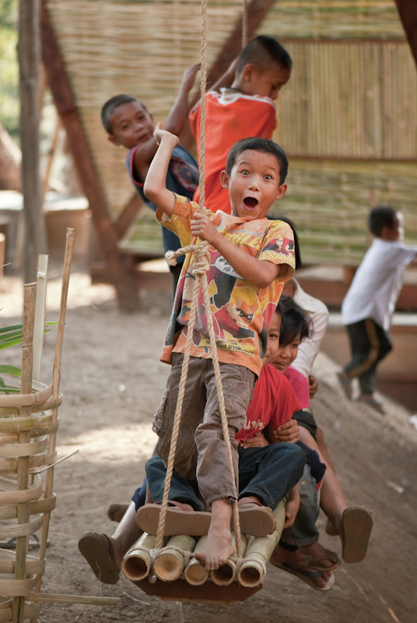
2. Project Goals

Slide 7
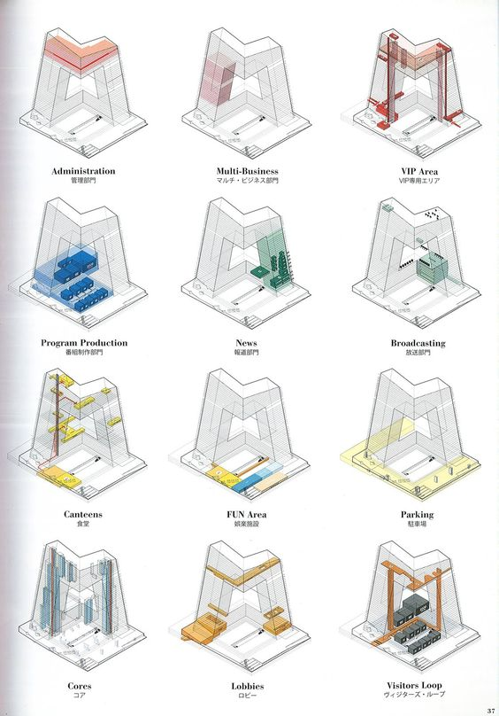
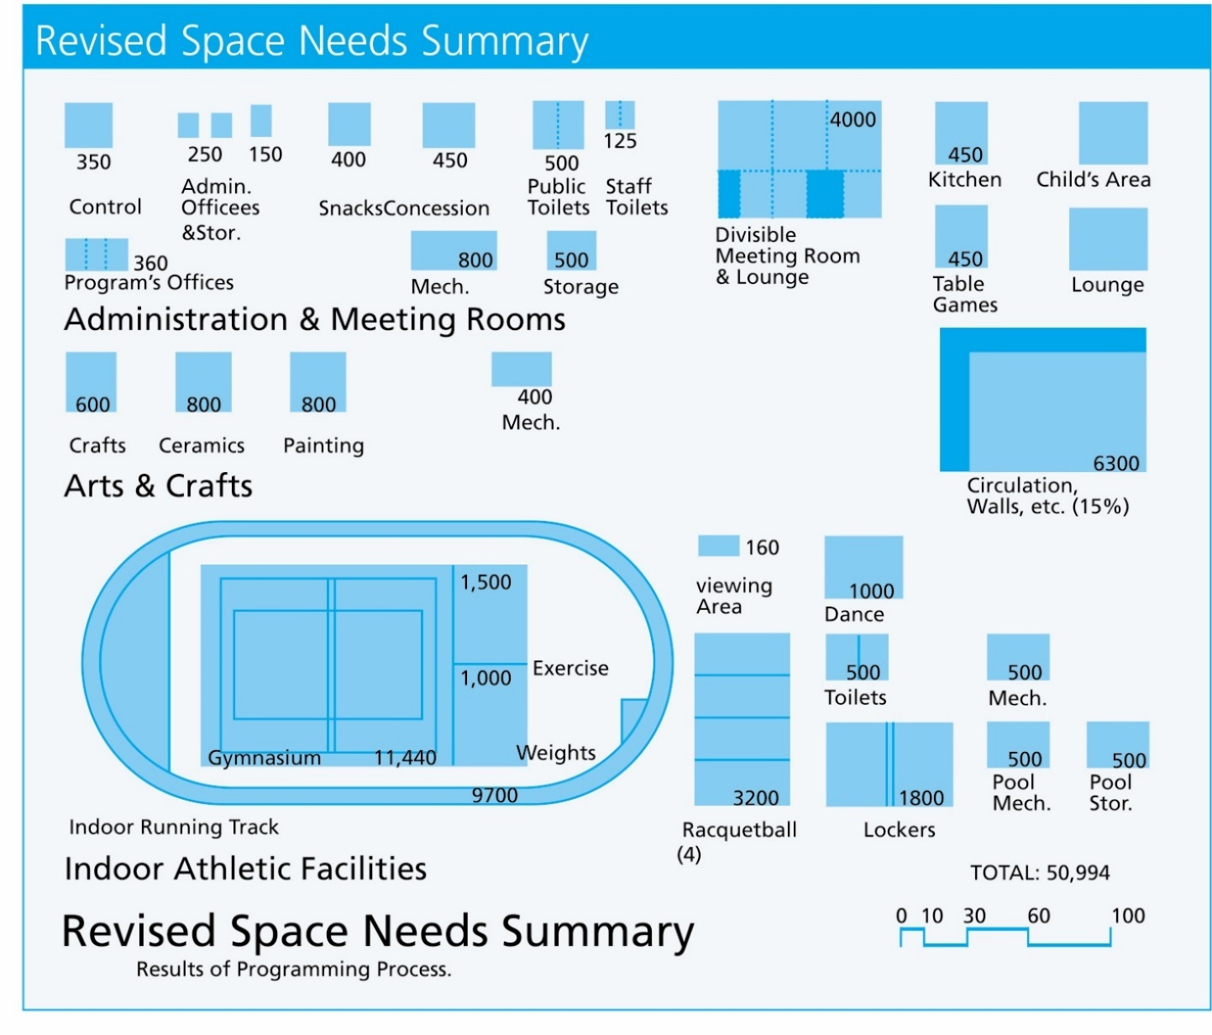
3. Develop Facility Requirements

Slide 8
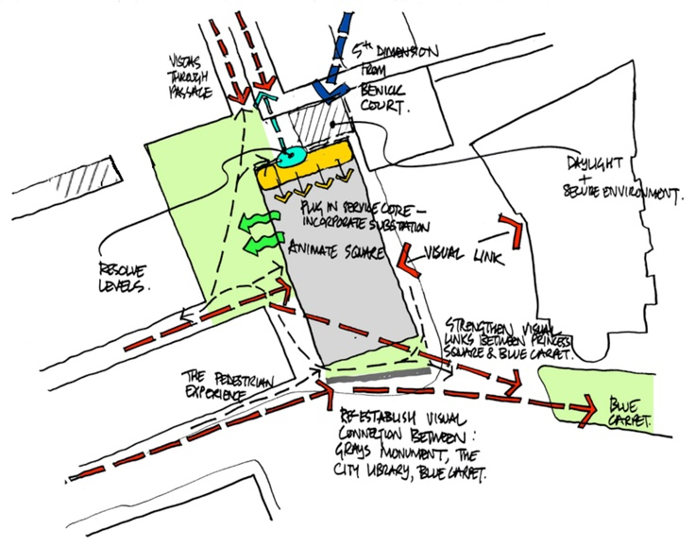
4. Information Gathering

Slide 9
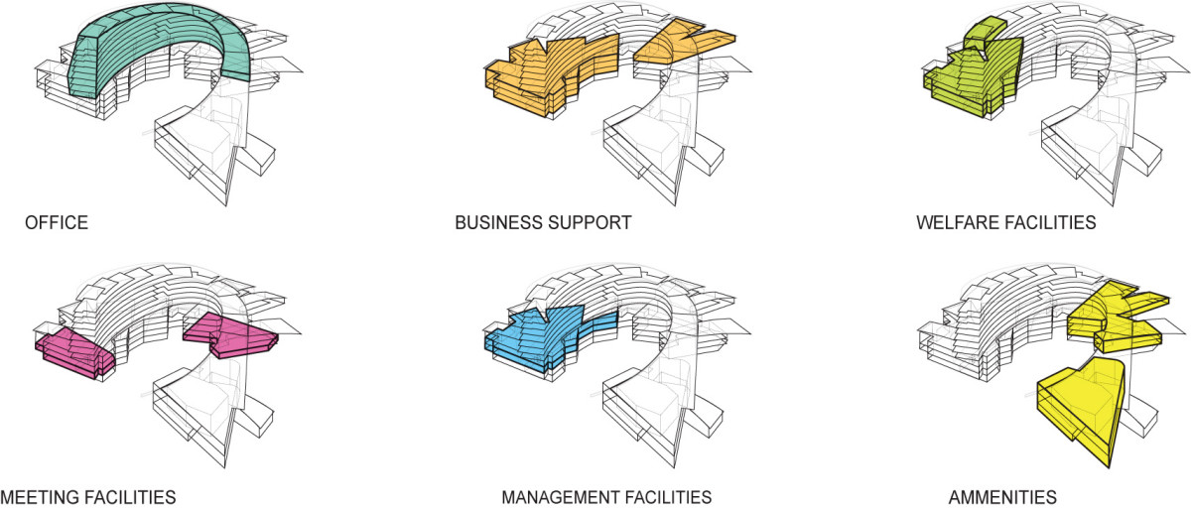
5. Deliverables

Slide 10
SPOILER ALERT!
We interrupt your regularly scheduled programming to bring you this very important public service announcement.

Slide 12
+POOL (2010-present)

Slide 13
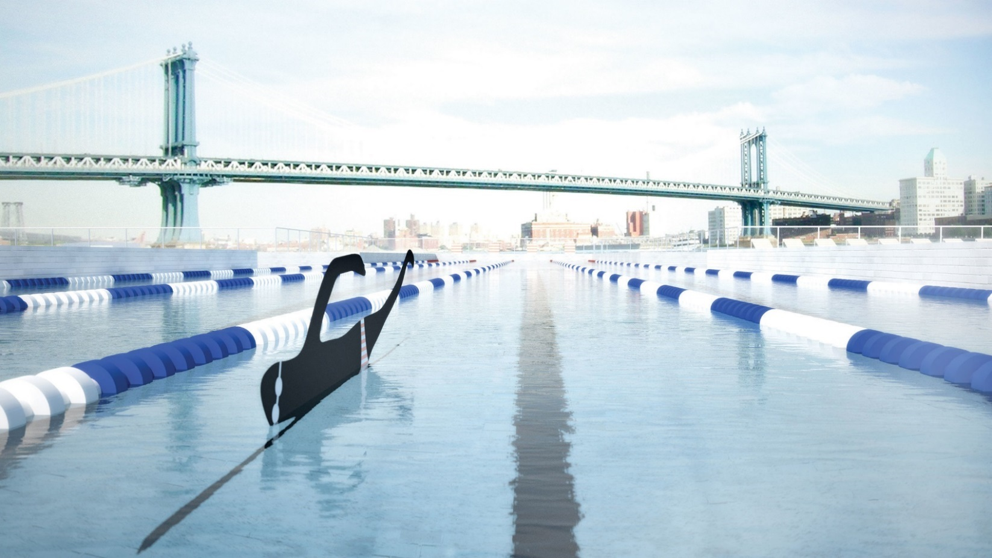

Slide 17
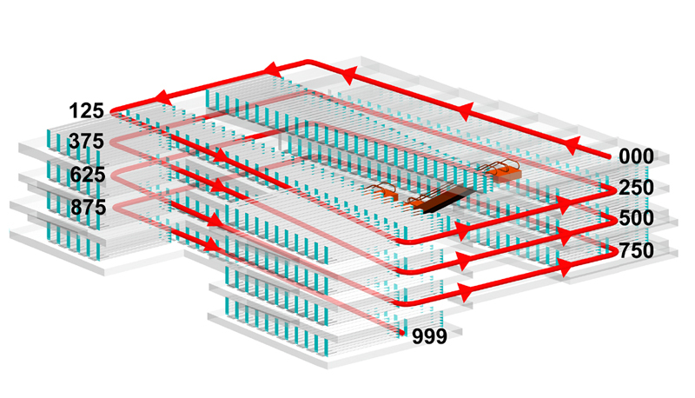
SEATTLE PUBLIC LIBRARY (1999-2004)

Slide 18
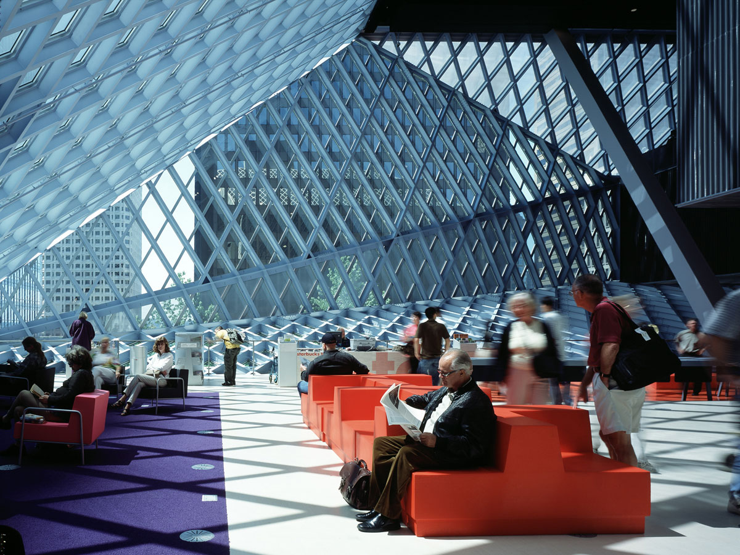

Slide 20
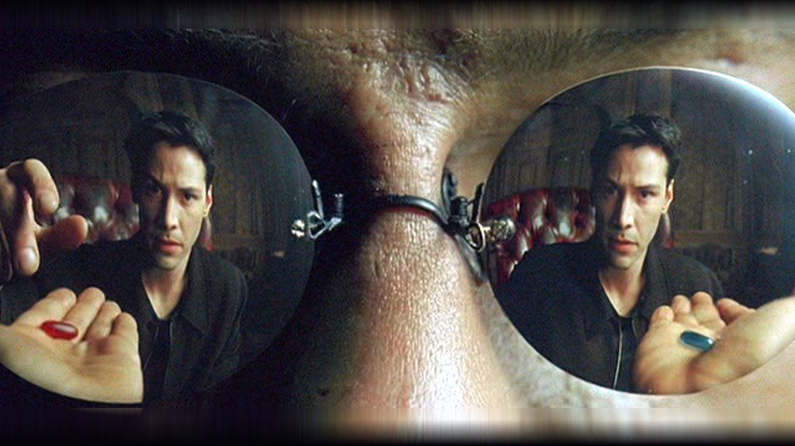
THANK YOU!
Shout Out to:
GE, Apple, Grumpy Cat, Architecture for Dogs, TYIN Architects, FAMILY, PlayLab, Arup; OMA, REX; ArchDaily, Deezen, Bustler, Architizer

